Slide 1

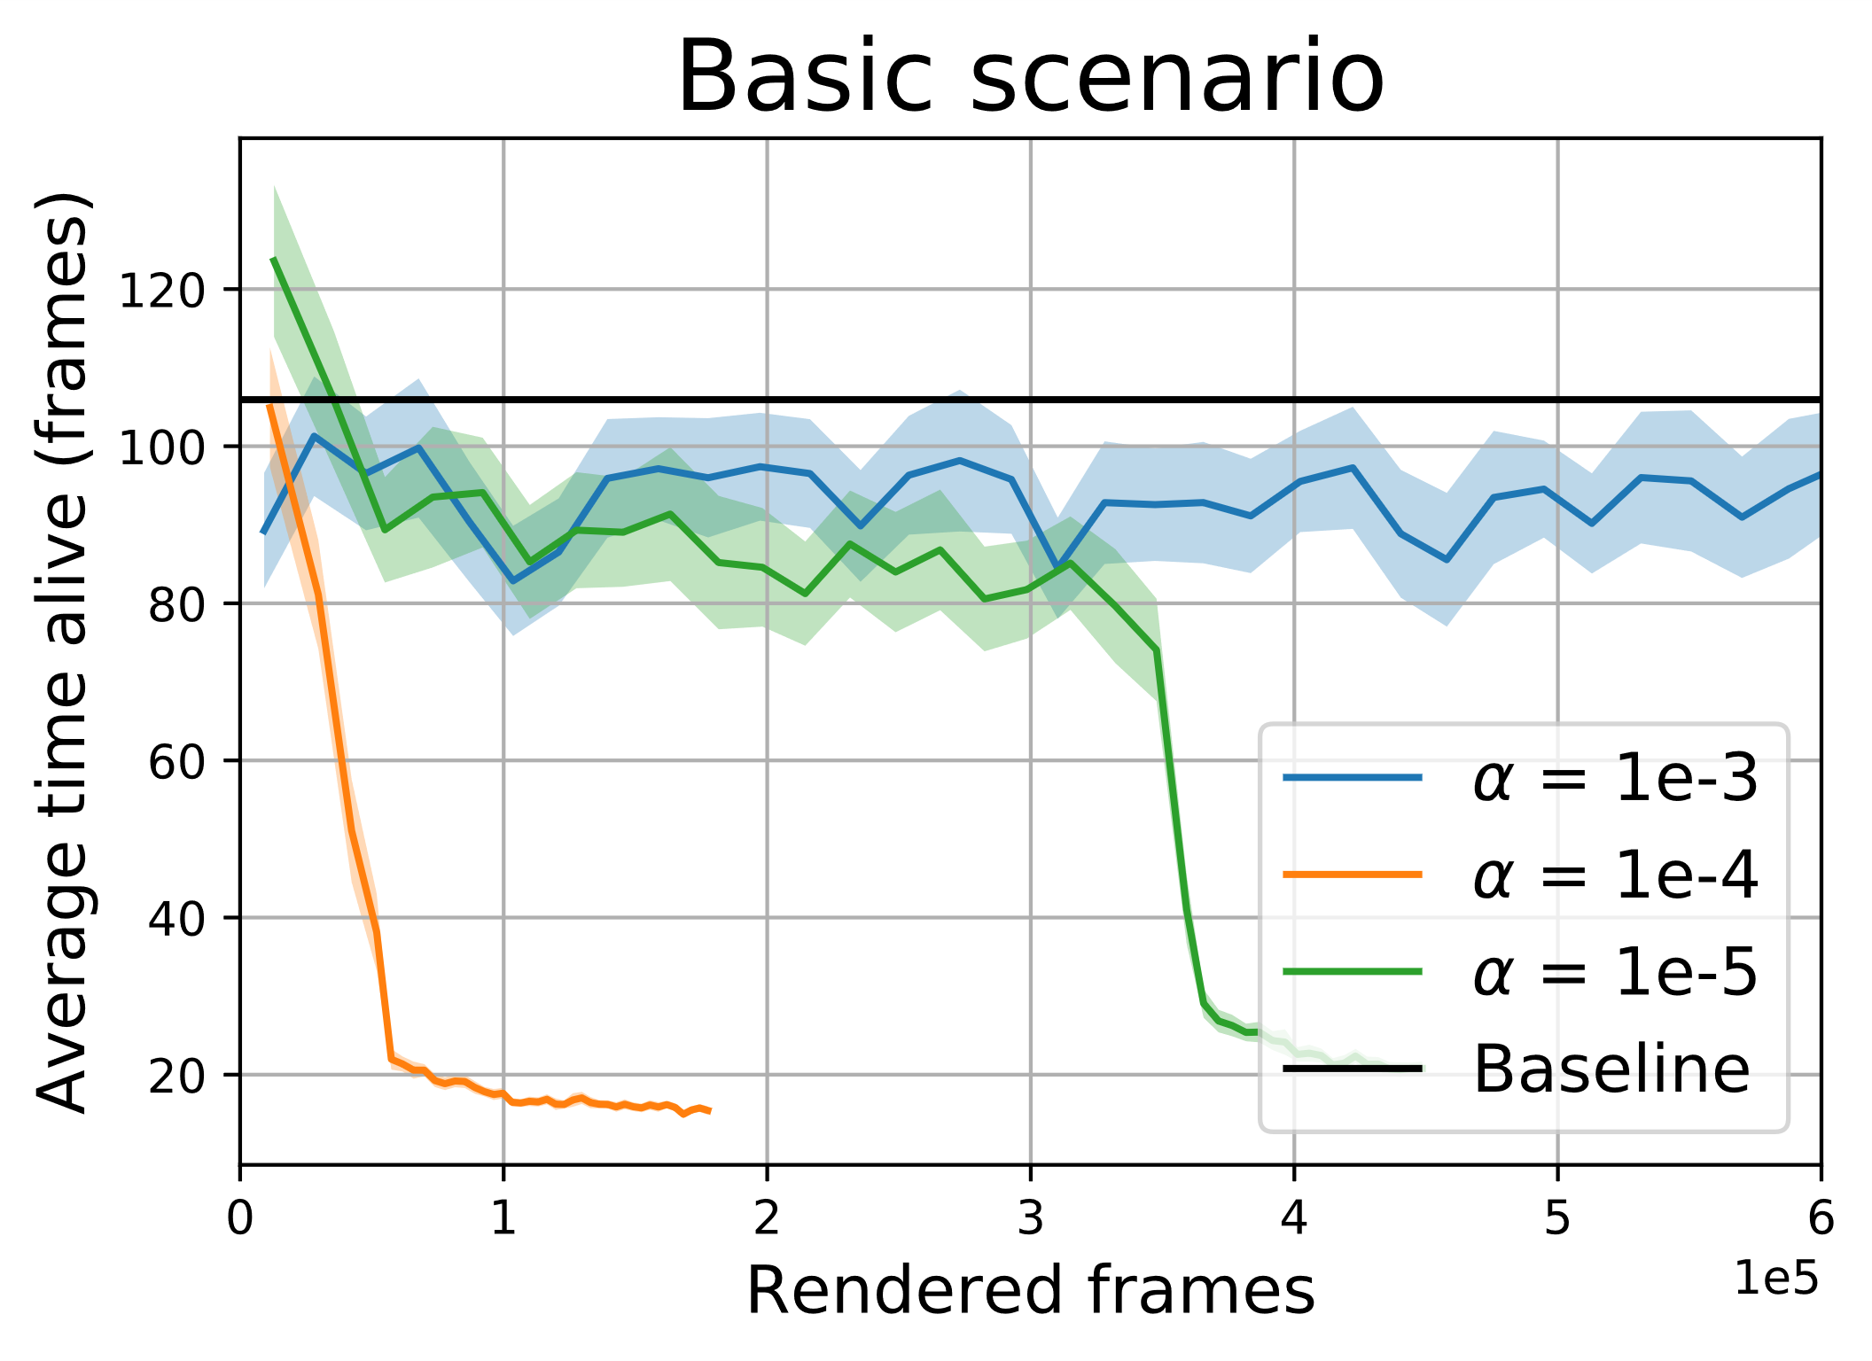
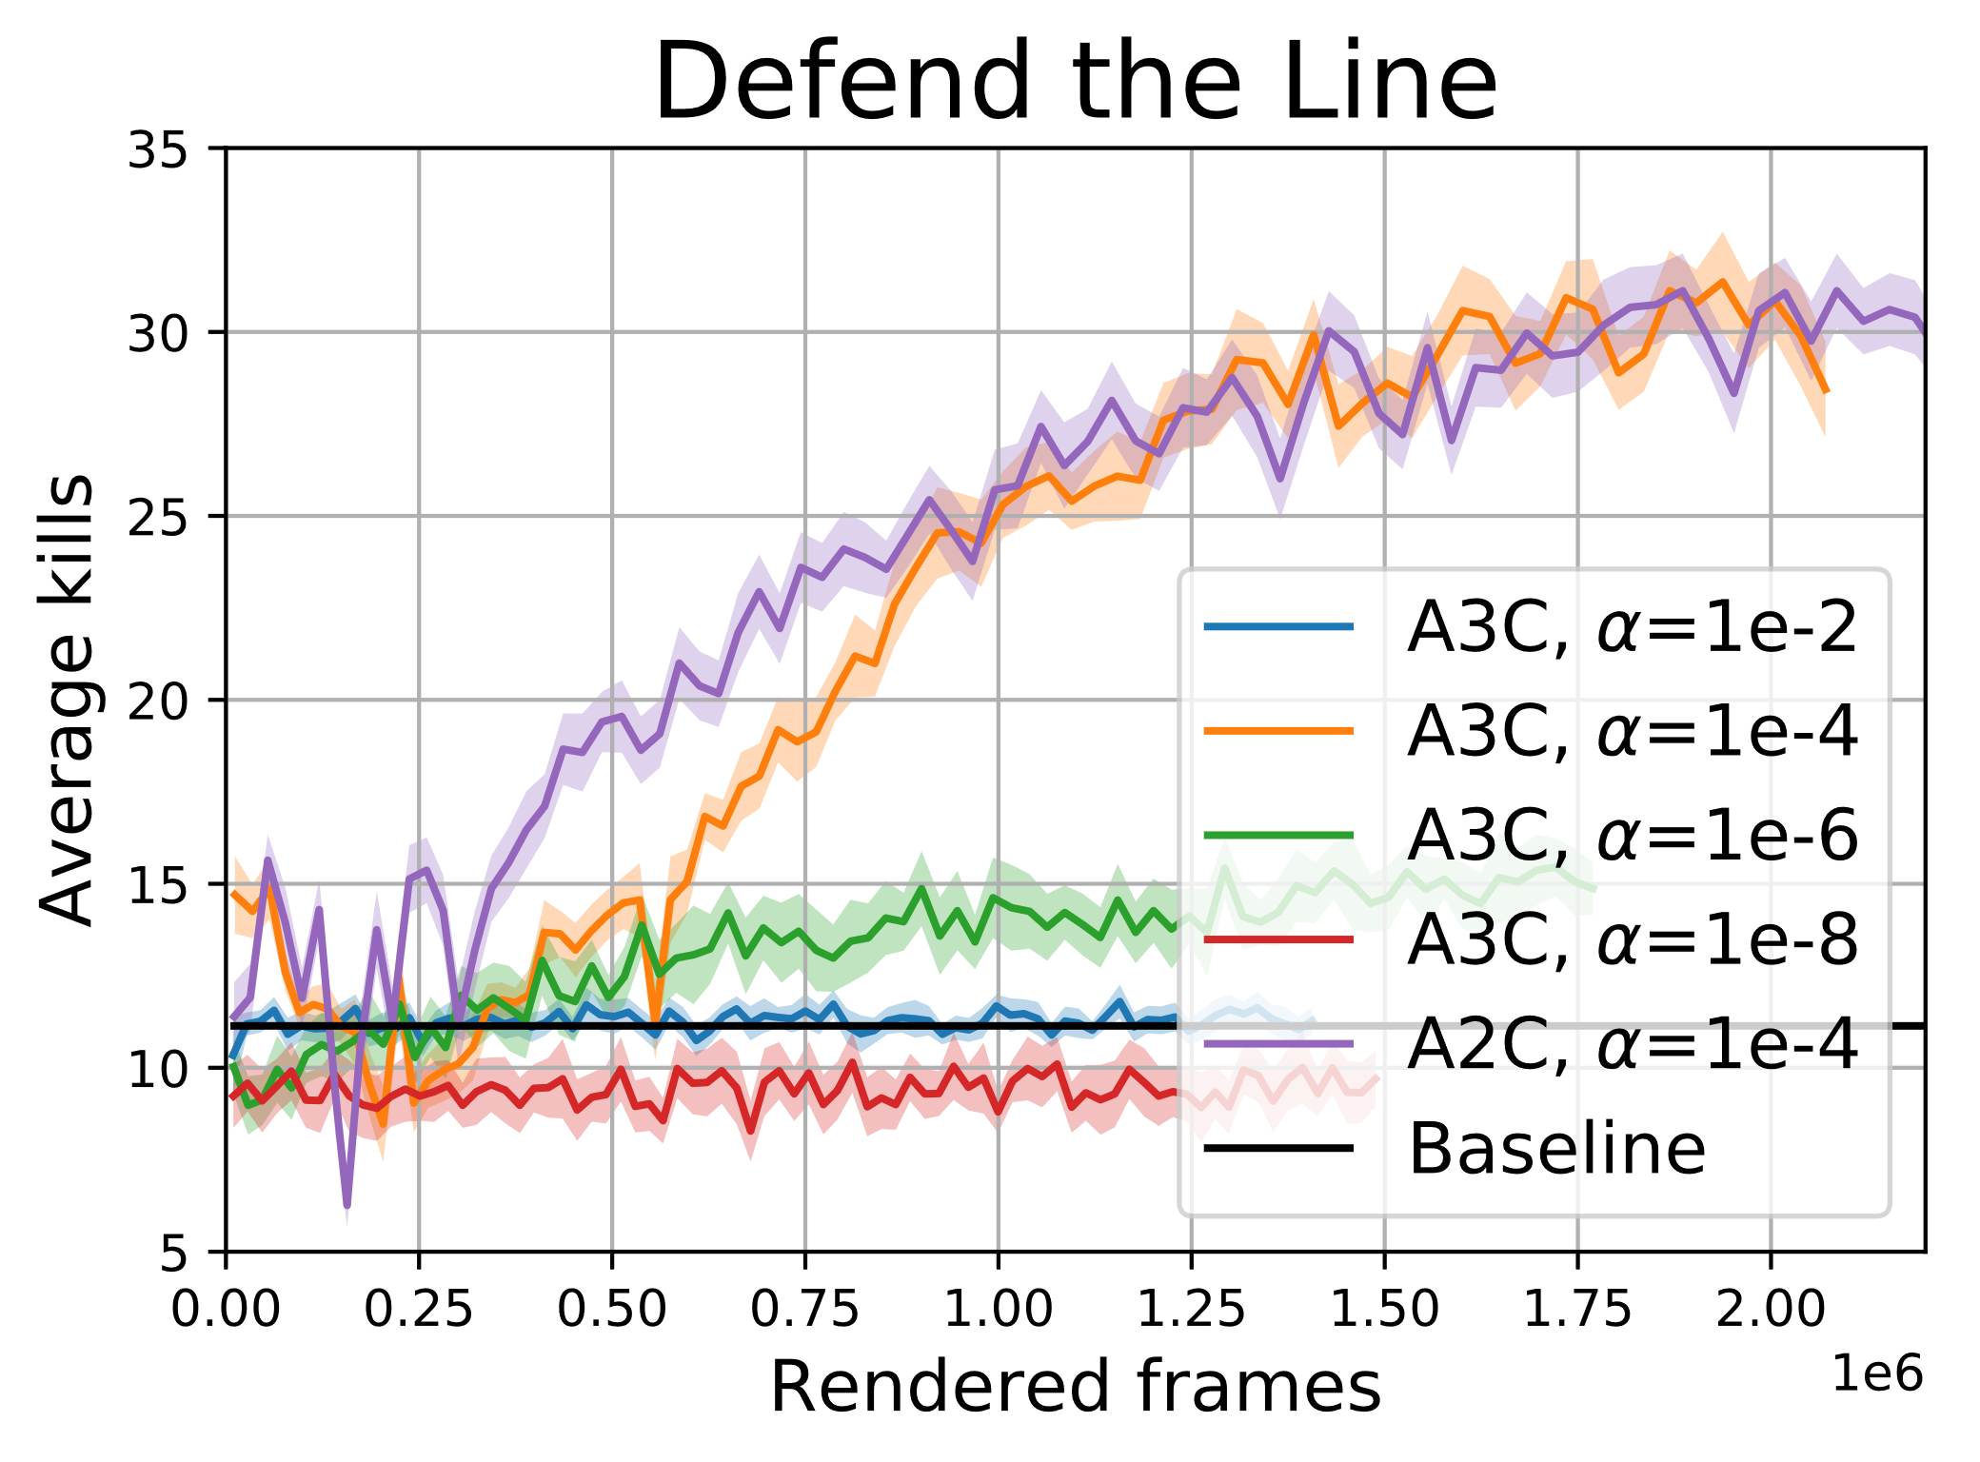
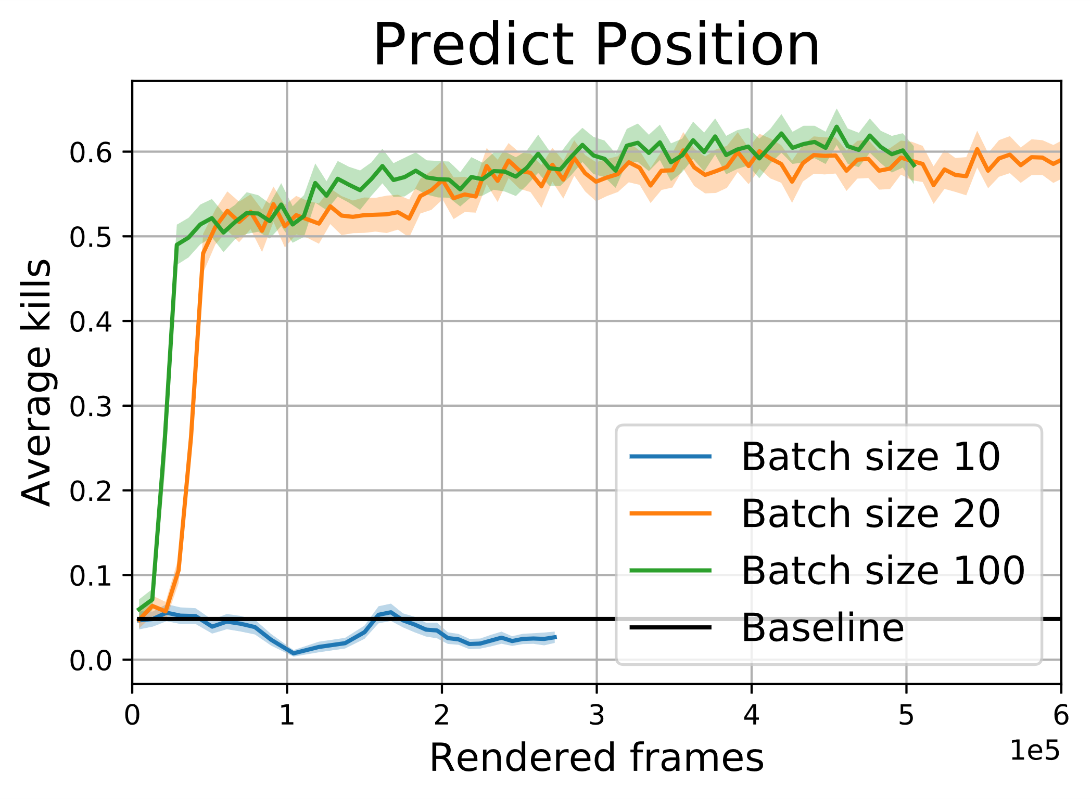
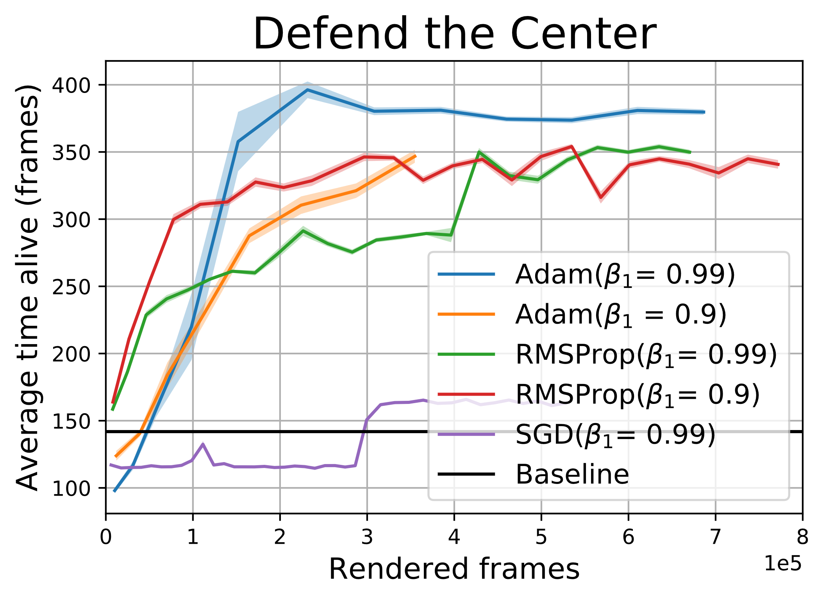
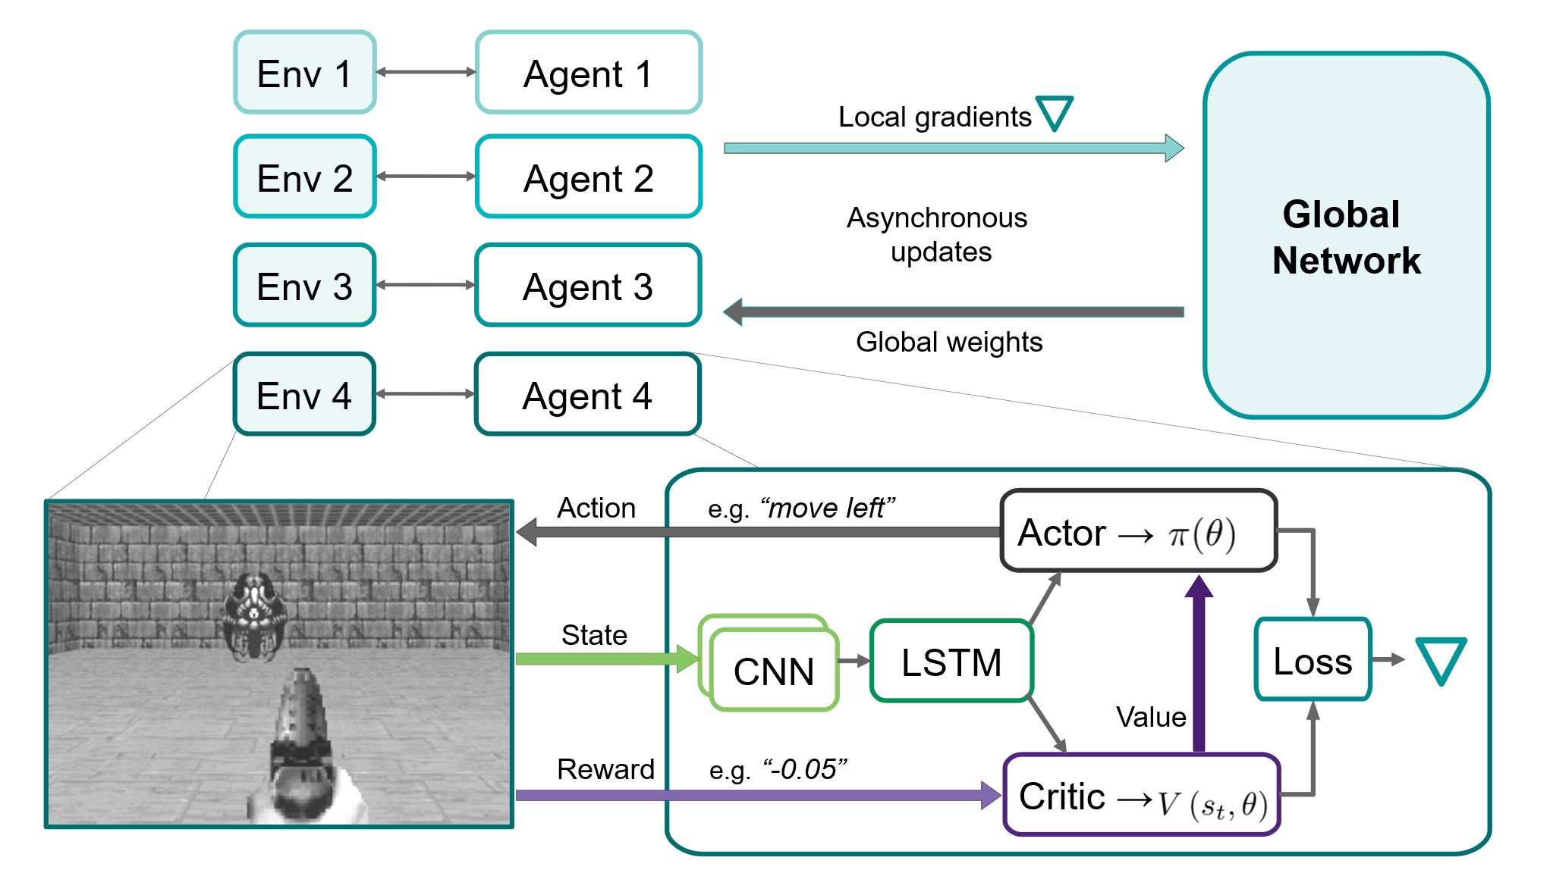


Asynchronous Advantage Actor-Critic Methods on
Aksel Obdrup (s144089), Elin Dijkstra (s182774), Louis Hein (s181573) & Tobias Konradsen (s144077) – DTU Compute – 02460 Advanced Machine Learning
Reinforcement learning algorithms learn behavior in various environments based on rewards for actions.
ViZDoom: Partially observable environment with sparse or delayed rewards
Other implementations based on experience replay are computationally heavy and potentially unstable
→ Asynchronous approach proposed
Learning is sensitive to experiment settings
Learning rate: Optimal found ${10}^{−4}$
A2C/A3C: Similar learning curve
Batch size: Scenario dependent, larger than 10
Optimizers: Adam outperforms RMSProp and SGD
Non trivial behavior on all presented scenarios
Notes:
Introduction (Louis):
Why choose this project?
Reinforcement learning is COOL.
Not supervised or unsupervised. RL: reward signal
Biology inspired
ViZDoom
Partial observable, semi realistic, first person
Lightweight and fast
High customizable
Interesting since sparse/ delayed reward
Credit Tue
Research community, AI competition
General Reinforcement learning
States bla bla
Other algorithms depend on experience replay
Outline structure presentation
Our algorithm (Tobias)
General outline figure
Four independent agents, each own copy of enviroment (initially same enviroment).
All gather different experience
Lets zoom in on what one agent does
One agent
-The oberservation of the environment (State reward action/actionspace )
- With the policy(actor) is a mapping of the states to the actions.
-The state is processed of the neural network. CNN LSTM
-The the critic is estimated a value function, from previous rewards.
A3C
-For each of these agent a gradient of the loss is calculated and global and local network is updated.
Better learning decorrelated updates.
Learning rate results (Aksel)
- What is a learning rate? Why important?
Basic scenario: Explanation and motivation for starting with this
Kill as fast as possible – relate to learning curve
Small sd for best learning rate
To confirm: more challenging scenario > rendered frame
Intro: defend the line
Tendency to shoot wildly and reward shape
A2C vs A3C
Similair curves, long wallclock for A2C
Batch size and Optimizers and conclusions/outro (Elin)
Intro batch size
Intro scenario -> delayed and sparse reward, estimate position
In other scenarios, standard batch size 10
Since sparse reward so sometimes no reward, larger batchsize needed
So far: all Adam because recommended
Intro Optimizers, momentum and decay
Intro Defend the center
Adam outperforms, so good inital choice
Good performance on all scenarios
Learned a lot about learning and ideas how to procede.
Hope to use in the future

